Slide 1
Summarizing Basic Cryptographic Concepts
Notes:
This lesson starts the next block of the course, which is focused on the protect function. The first part of this will cover IAM topics, and cryptography underpins most of these technologies.
Topics:
Compare and contrast cryptographic ciphers.
Summarize cryptographic modes of operation.
Summarize cryptographic use cases and weaknesses.
Summarize other cryptographic technologies.

Slide 2
Compare and Contrast Cryptographic Ciphers
Notes:
This topic covers the basic cryptographic primitive types: hashing, symmetric ciphers, and asymmetric ciphers.
Objective 2.8 is covered over the course of all the topics in this lesson.
It is easy for students to become confused about the different types of cryptographic systems, so allocate plenty of time to covering this topic.

Slide 3
Syllabus Objectives Covered
2.1 Explain the importance of security concepts in an enterprise environment (Hashing only)
2.8 Summarize the basics of cryptographic concepts

Slide 4
Cryptographic Concepts
Encryption and decryption—encoding and decoding
Plaintext is the unencoded message
Ciphertext is the coded message
Cipher is the means of change or algorithm
Cryptanalysis is the art of cracking cryptographic systems
Meet Alice and Bob (and observe Mallory, lurking)
Hashing algorithms
Encryption ciphers
Symmetric
Asymmetric
Notes:
Note that in cryptography there is still some "obscurity" involved as you have to control distribution of the key. This is a simpler job than protecting the design of the algorithm, however.
Passive eavesdropping is traditionally performed by Eve, but we're just using Mallory for simplicity.

Slide 5
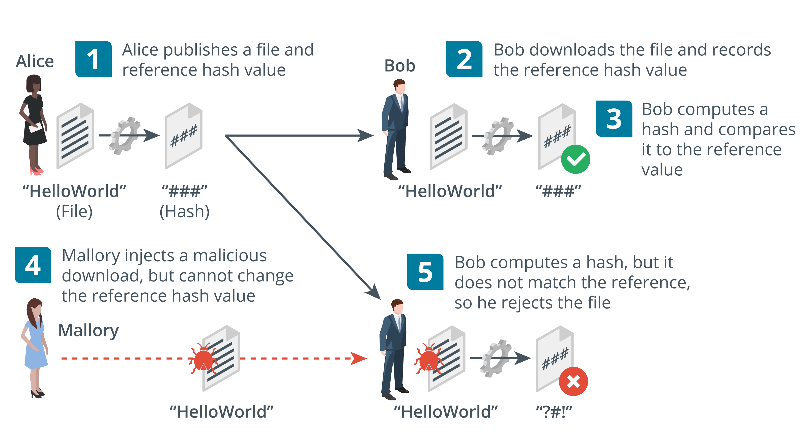
Hashing Algorithms
Fixed length hash from variable string with cryptographic properties
One-way (plaintext cannot be recovered from the digest)
Anti-collision (no two plaintexts are likely to produce the same checksum)
Used for password storage and checksums (integrity)
Secure Hash Algorithm (SHA)
Message Digest Algorithm (MD5)
Images © 123rf.com.
Notes:
Hash functions are mostly used for integrity (signatures and message digests) and password storage (confidentiality).
While the names of cryptographic algorithms have been removed from the certification objectives, they are still present in the acronyms list, and the injunction on the acronyms list is "Candidates are encouraged to review the complete list and attain a working knowledge of all listed acronyms as part of a comprehensive exam preparation program." Consequently, the names of the main products have been retained.
The syllabus also uses the term checksum for a message digest (under the forensics objective) so we are using that here too. You might want to note that hash functions produce a specific type of checksum, but there are others with different properties, such as a parity checksum.

Slide 6
Encryption Ciphers and Keys
Hashing is not encryption—the process is not reversible
Encryption uses a reversible process based on a secret
Process should be too complex to unravel without the secret
Substitution
Transposition
Cannot keep the cipher/algorithm itself secret
Key ensures ciphertext remains protected even when the operation of the cipher is known
Protecting the key is easier than protecting the algorithm
Notes:
Make sure students understand the difference between the cipher and the key.
You could also mention that most types of encryption make use of the XOR function.

Slide 7
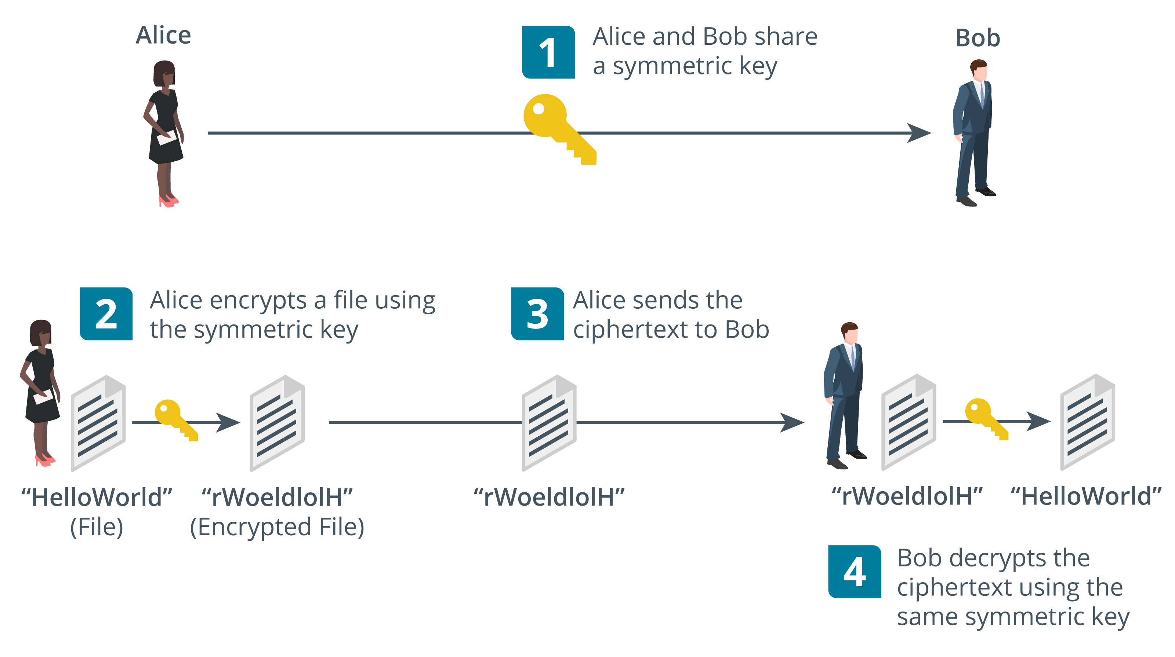
Symmetric Encryption
Same secret key is used for encryption and decryption
Fast—suitable for bulk encryption of large amounts of data
Problem storing and distributing key securely
Confidentiality only— sender and recipient know the same key
Images © 123rf.com.
Notes:
Note that symmetric encryption is mostly used for privacy (confidentiality). Test that the students can explain to you why it cannot be used for authentication, integrity, or non-repudiation.

Slide 8
Stream and Block Ciphers
Stream ciphers
Encrypt and decrypt each bit/byte at a time
Must be used with an initialization vector (IV)
Block ciphers
Treat data as equal-size blocks, using padding if necessary
Advanced Encryption Standard (AES/AES256)
Key length
Range of key values is the keyspace
Longer key bit length means a larger keyspace
Strength of key of any given length varies between ciphers
Notes:
We will get to it in the next topic, but you might want to point out here that various counter modes can be used to turn AES into a stream cipher.
You might also want to note that RC4 is an obsolete stream cipher and the use of ChaCha20 as a modern stream cipher. These should not be required for the exam, but students will encounter them regularly as security professionals.

Slide 9
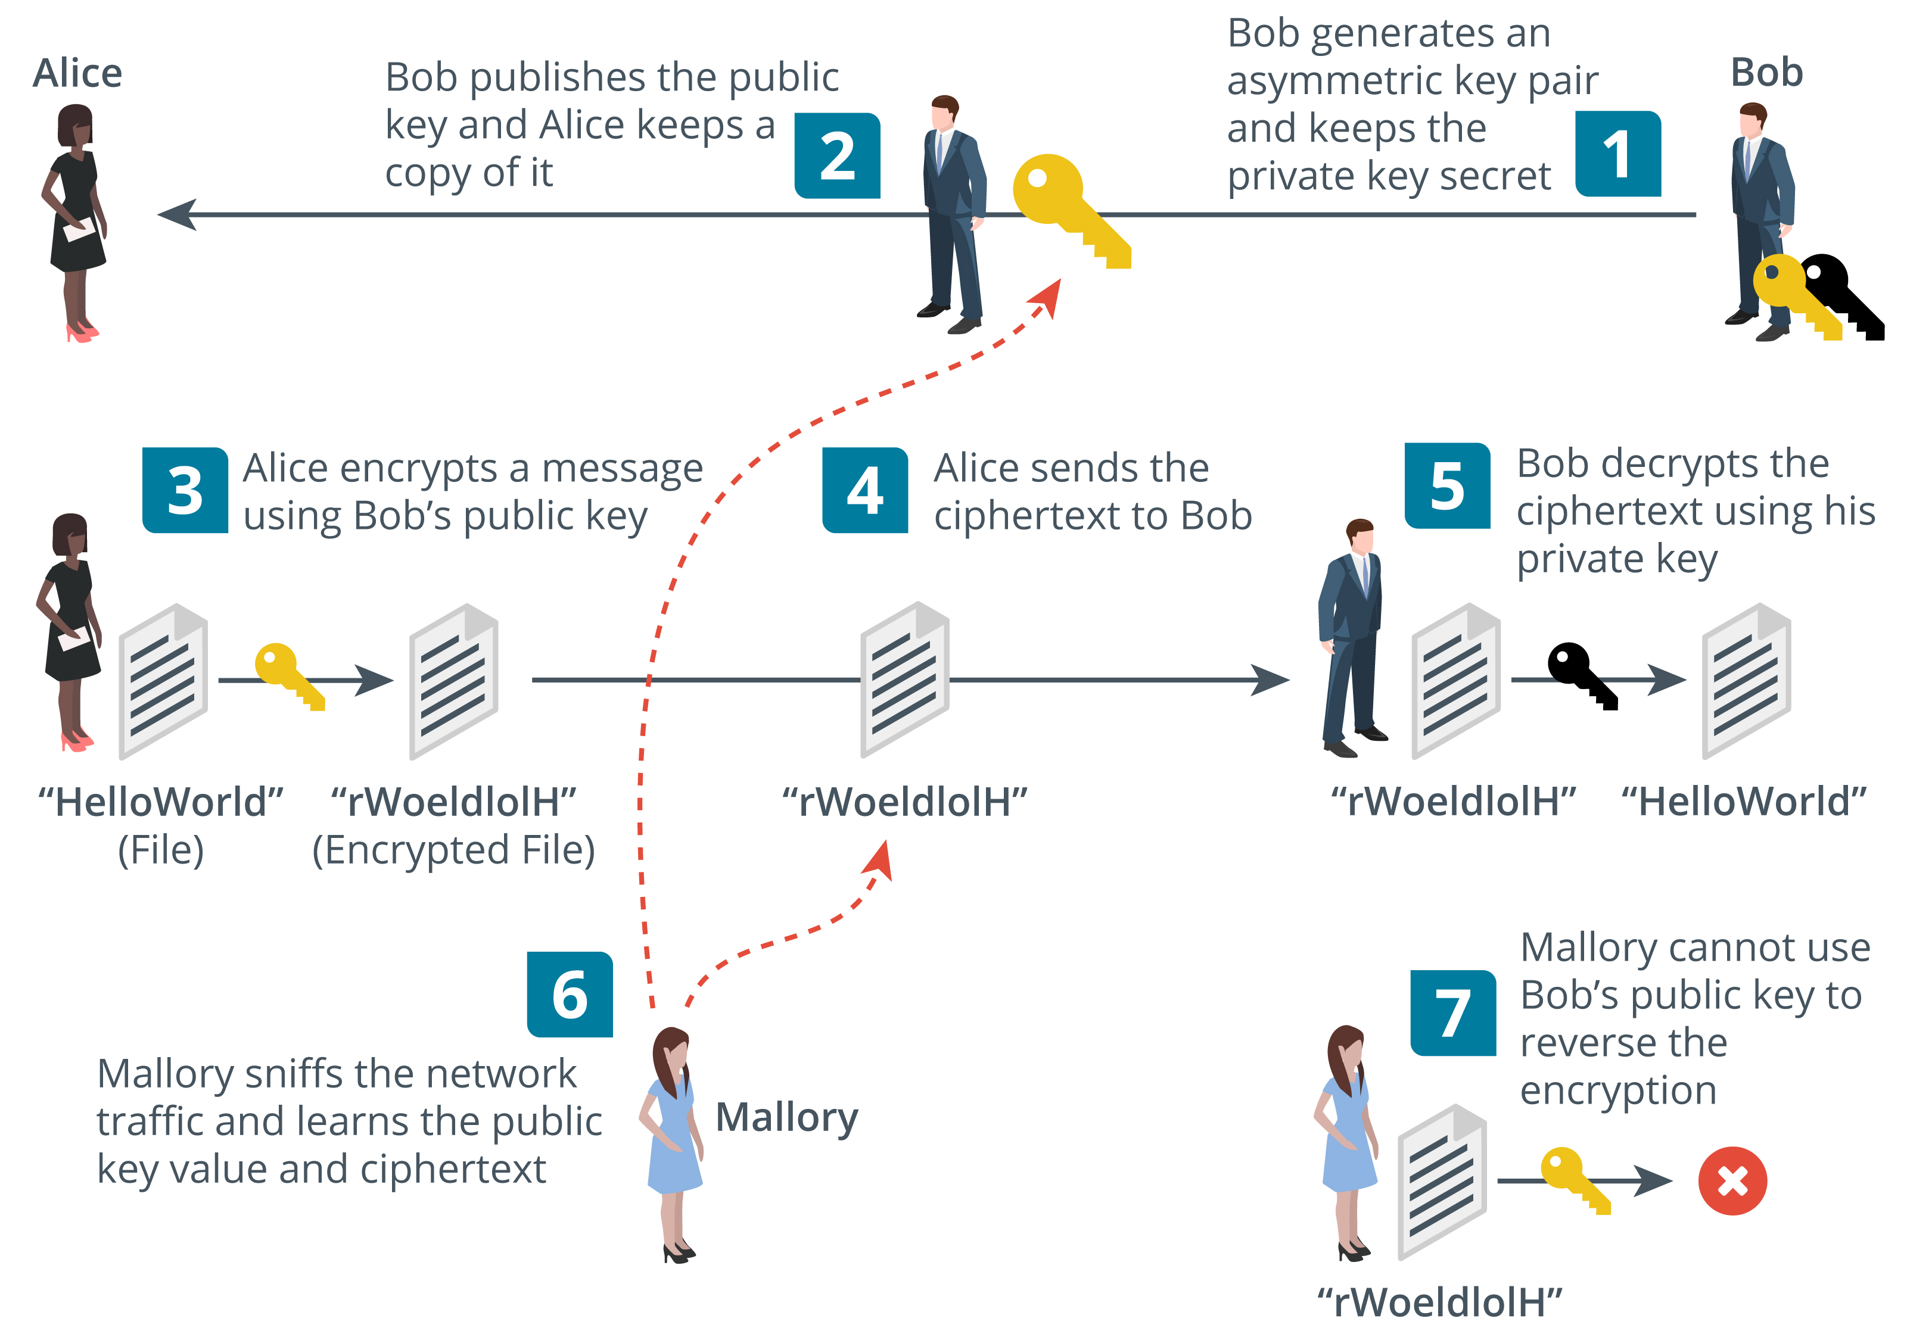
Asymmetric Encryption
Public/private key pair
If the public key encrypts, only the private key can decrypt
If the private key encrypts, only the public key can decrypt
Private key cannot be derived from the public key
Private key must be kept secret
Public key is easy to distribute (anyone can have it)
Message size is limited to key size so not suitable for large amounts of data
Used for small amounts of authentication data
Images © 123rf.com.
Notes:
Asymmetric ciphers are mainly used for authentication and non-repudiation. Another important use is key exchange. A symmetric encryption key is encrypted by the client and sent to the server. The server decrypts the key and that secret key is then used to encrypt messages sent between server and client.

Slide 10
Public Key Cryptography Algorithms
RSA algorithm (Rivest, Shamir, Adleman)
Basis of many public key cryptography schemes
Trapdoor function
Easy to calculate with the public key, but difficult to reverse without the private key
Elliptic curve cryptography (ECC)
Concerns about RSA being vulnerable to cryptanalysis
Another type of trapdoor function
Can use smaller keys to obtain same security
Notes:
There's not much point trying to describe ECC without mentioning RSA.

Slide 11
Cryptographic Ciphers

Slide 12
Summarize Cryptographic Modes of Operation
Topic 5B
Notes:
This topic moves on from the basic cryptographic types to showing how they are used together in cryptographic implementations, such as digital signatures and transport encryption.

Slide 13
Syllabus Objectives Covered
2.8 Summarize the basics of cryptographic concepts

Slide 14
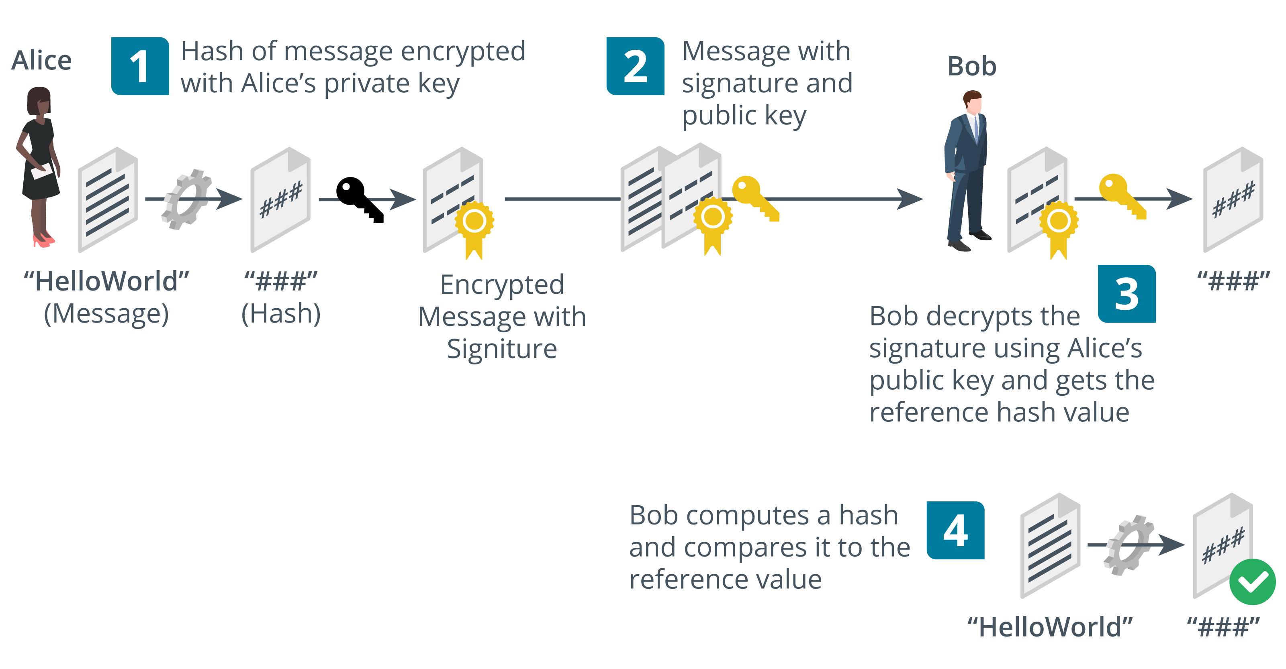
Digital Signatures
Using public key cryptography with hashing
Digital signatures provide integrity, authentication, non-repudiation
RSA-based digital signatures
Digital Signature Algorithm (DSA) with ECC cipher
Images © 123rf.com.
Notes:
Digital signatures combine public key cryptography with hashing algorithms to provide authentication, integrity, and non-repudiation.

Slide 15
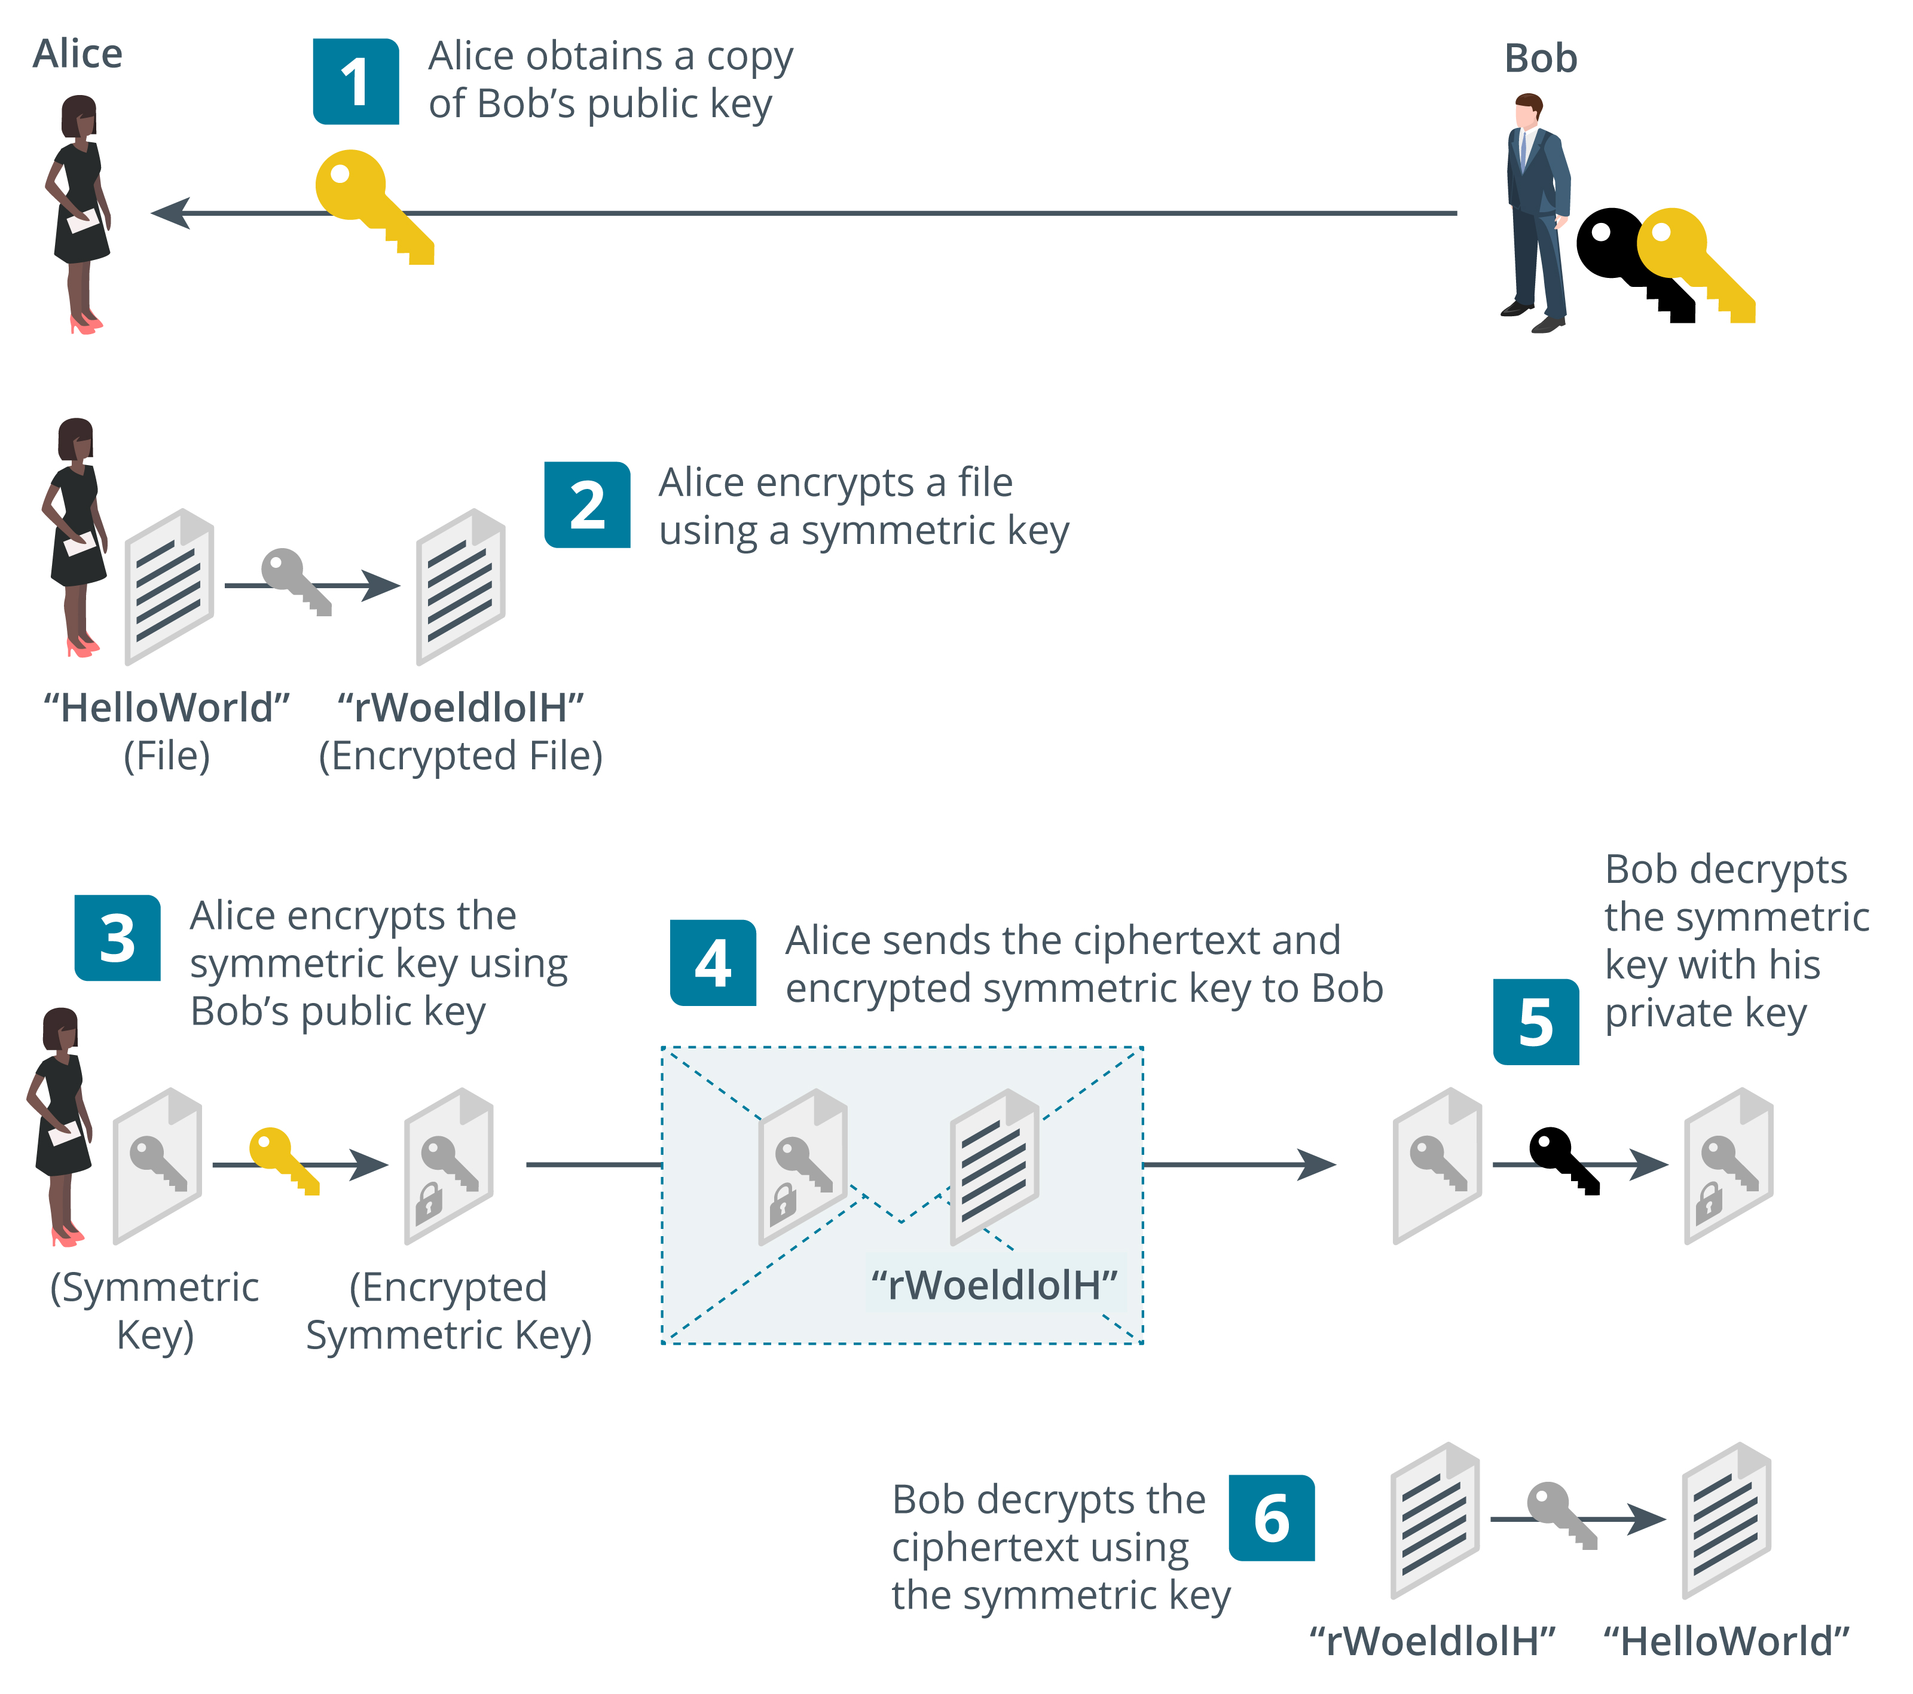
Digital Envelopes and Key Exchange
Images © 123rf.com.
Notes:
Stress that asymmetric encryption is slow and so is only used on small amounts of data (signing hashes or encrypting secret keys).

Slide 16
Digital Certificates
Wrapper for a public key to associate it with a digital identity
Identity assertion is validated by a certificate authority (CA) by signing the certificate
Both parties must trust the CA
Referred to as public key infrastructure (PKI)
Notes:
We will explore certificates and PKI in more detail in the next lesson.

Slide 17
Perfect Forward Secrecy
RSA key exchange decrypts the session key using the server private key
The private key stored on the server may be compromised in the future
If key is compromised, previously captured transmissions could be deciphered
Perfect forward secrecy (PFS) mitigates this issue
Uses Diffie-Hellman key agreement protocols
Allows two parties to derive the same secret value that an eavesdropper cannot guess
Notes:
The terms "key exchange" and "key agreement" are often taken to mean the same thing, but point out that there are different mechanisms. With key agreement, the client does not transmit an encrypted session key to the server. The client and server use Diffie-Hellman (D-H) to derive the same secret key value.
Note that in TLS 1.3, only PFS cipher suites are allowed. RSA key exchange is deprecated. The RSA algorithm can still be used for signing, however. The values exchanged as part of D-H need to be signed to prove authenticity and prevent a man-in-the-middle attack.

Slide 18
Cipher Suites and Modes of Operation
Cipher suite
Signature algorithm—proves messages were created by the server (authentication and integrity)
Key exchange/agreement algorithm—allows client and server to agree session keys
Bulk encryption cipher—uses the session key to keep the data confidential
Modes of operation
Use symmetric block cipher with arbitrary length network data
Cipher Block Chaining (CBC)
Combines blocks and an initialization vector (IV) using XOR operation
Data must be a multiple of block size so requires padding for last block
Counter mode
Generates keystream with IV and counter
Does not require block padding
Notes:
While the syllabus no longer mentions cipher block chaining (CBC; except as under CCMP and in the acronym list), it is included here to help to explain the problems that arise from padding and the necessity of using counter mode/stream ciphers.
The acronym list also continues to list rarely implemented modes, such as ECB and CFB. Hopefully, students should not need to know these, but you may want to point them out.
Note that in TLS 1.3, the signature and key agreement algorithms are no longer part of the actual suite. The signature algorithm is provided via the server's digital certificate and key agreement is always Diffie-Hellman.

Slide 19
Authenticated Modes of Operation
Unauthenticated encryption
Secret key encryption cannot prove integrity
Makes cryptographic system vulnerable to insertion and modification attacks
Authenticated encryption
Message authentication code (MAC)
Create a hash from combination of the message and a shared secret
Implementations vulnerable to padding oracle attacks
Authenticated encryption with additional data (AEAD)
Counter modes or stream ciphers that do not use padding
Associates message with context to prevent replay
Notes:
Students should not need to recognize the cipher suite names for the exam, but in practical terms they would be highly recommended to learn them anyway, not least because TLS 1.3 is reduced to just three algorithms. Consequently, we are including the relevant acronyms for recognition purposes, but not trying to explain the difference between, say, GMAC and CBC-MAC.

Slide 20
Cryptographic Modes of Operation

Slide 21
Summarize Cryptographic Use Cases and Weaknesses
Topic 5C
Notes:
Having established the types of cryptographic function and the use of hybrid encryption, this topic covers use cases, limitations, and weaknesses. We also look at the cryptographic attacks content examples from objective 1.2.

Slide 22
Syllabus Objectives Covered
1.2 Given a scenario, analyze potential indicators to determine the type of attack
2.8 Summarize the basics of cryptographic concepts

Slide 23
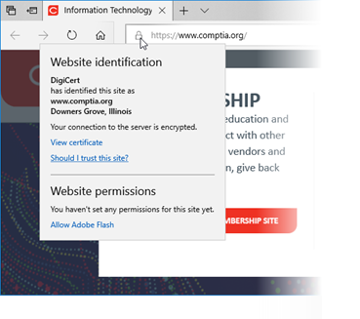
Cryptography for Authentication and Non-repudiation
Cryptographic primitives versus cryptographic systems
Authentication and access control
Assuming the private key is secure, an encrypted token could only have been created by the key holder
Non-repudiation
Sender cannot deny (repudiate) the message as only she/he could have created it
Screenshot used with permission from Microsoft.
Notes:
This section and the next aim to reinforce the content presented in the previous topic. If students have formed a good understanding of the way digital signatures and hybrid encryption support these use cases, you can skip this section and the one on confidentiality and consider resiliency and performance issues.

Slide 24
Cryptography Supporting Confidentiality
Hybrid encryption
Public key cryptography is only efficient with small amounts of data
Symmetric encryption makes key distribution difficult
Symmetric key is used for bulk encryption and protected by public key cryptography
File encryption
Private key encrypts the symmetric key
Use of the key is locked to a user account credential
Transport encryption
Session key exchange/agreement

Slide 25
Cryptography Supporting Integrity and Resiliency
Integrity
Using hash functions and message authentication codes to validate messages
Resiliency
Using cryptography to ensure authentication and integrity of control messages
Obfuscation
Make something hard to understand
Encryption can perform this function, but it is very hard to secure an embedded key
White box cryptography
Notes:
GCHQ’s Dr Ian Levy's article on designing the security system for smart meters in the UK (ncsc.gov.uk/information/the-smart-security-behind-the-gb-smart-metering-system) is a good example of some of the considerations that go into the design of a highly resilient system.

Slide 26
Cryptographic Performance Limitations
Limitations
Speed—Amount of data/number of operations per second
Time/latency—Delay in completing an operation
Size—Key size increases security but also CPU/memory requirements
Computational overhead—Complexity of cryptographic implementation or cipher
Resource-constrained environments
Low-power devices
Battery-powered systems
Contactless smart cards
Low latency
Delay-sensitive communications protocols/implementations
Notes:
The syllabus places a lot of emphasis on limitations and use cases, so make sure students understand these factors.

Slide 27
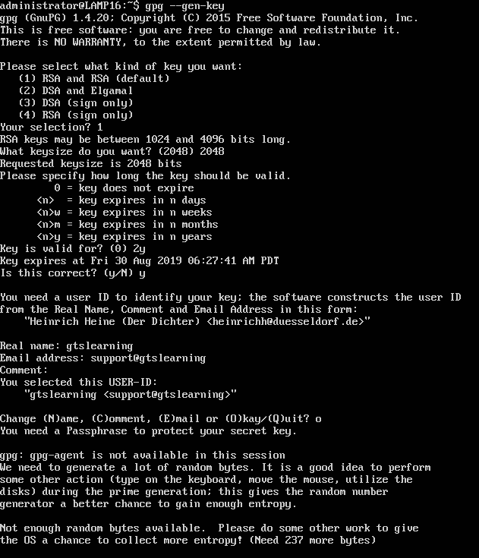
Cryptographic Security Limitations
Entropy
Checksums and ciphertext must reduce order (high entropy)
Weak ciphers and weak keys
Weak implementations
Weak randomness
Predictability and reuse
Nonce
Initialization vector (IV)
Salt
Notes:
You can illustrate a weak key problem by referencing the Debian OpenSSL vulnerability. Two lines of code in Debian's OpenSSL package were removed when highlighted by a debugging application. These two lines were responsible for ensuring that the keyspace was large and random. Consequently, for two years, Debian OpenSSL servers using this patch were generating keys from a range of about 32,000. Another example is the NSA-inserted backdoor in a RNG proposed for use with ECC (isaca.org/resources/isaca-journal/issues/2016/volume-3/can-elliptic-curve-cryptography-be-trusted-a-brief-analysis-of-the-security-of-a-popular-cryptosyste).

Slide 28
Longevity and Cryptographic Attacks
How secure are current algorithms?
How long must a ciphertext be resistant to attacks?
Notes:
You might refer to Schneier's Law (schneier.com/blog/archives/2011/04/schneiers_law.html).

Slide 29
Man-in-the-Middle and Downgrade Attacks
Man-in-the-Middle (MitM)
Interferes with the public key presented to the client
Downgrade attack
Forces server into using weak protocol versions and ciphers

Slide 30
Key Stretching and Salting
User-generated data is low entropy
Key stretching
Use additional rounds to strengthen keys
Makes attacker do more work so slows down brute force
Salting
Add a random value to each password when hashing it for storage
Prevents use of pre-computed hash tables

Slide 31
Collisions and the Birthday Attack
Exploit collisions to forge a signature
Math of birthday paradox shows that this might be easier than expected
Chosen prefix collision attacks

Slide 32
Cryptographic Use Cases and Weaknesses

Slide 33
Summarize Other Cryptographic Technologies
Topic 5D
Notes:
This topic collects the remaining content examples from objective 2.8. While students need to know these for the exam, they are not critical to understanding authentication and authorization technologies. If students are feeling overloaded, you may want to skip this topic or leave it to later in the course.

Slide 34
Syllabus Objectives Covered
2.8 Summarize the basics of cryptographic concepts

Slide 35
Quantum
Quantum computing
Quantum bit (qubits), superpositions, entanglement and collapse
Quantum computers can keep track of a lot of state data at the same time
Communications
Tamper-evident key distribution
Post-quantum
Quantum-based cryptanalysis
Post-quantum cryptography (replacements for the current algorithms)
Lightweight cryptography

Slide 36
Homomorphic Encryption
Supports data analytics functions while preserving confidentiality and privacy
Notes:
We're keeping this here as part of objective 2.8, but note that it relates more to data privacy, which we'll get to later in the course.

Slide 37
Blockchain
Expanding list of transactional records (blocks)
Each block is linked by hashing
Public ledger
Ledger of transactions performed on a digital asset
Peer-to-peer so transactions are public
Transactions cannot be deleted or reversed
Widely used for cryptocurrencies
Potential uses for financial transactions, online voting systems, identity management systems, notarization, data storage, …

Slide 38
Steganography
Concealing messages within a covertext
Often uses file data that can be manipulated without introducing obvious artifacts
Image
Audio
Video
Covert channels
Notes:
There are various software applications for inserting and detecting steganographic messages. When hiding messages in files, a substitution technique such as least significant bit is preferable to simply inserting a message as it does not alter the file size.

Slide 39
Other Cryptographic Technologies

Slide 40
Summary
Lesson 5
Notes:
Check that students are confident about the content that has been covered. If there is time, revisit any content examples that they have questions about. If you have used all the available time for this lesson block, note the issues, and schedule time for a review later in the course.

